Slide 1
Potato Leaf Disease Prediction Project by using CNN
By S.Sowndarya

Slide 2
Problem Statement:
Farmers who grow potatoes are facing lot of economic losses every year because of Various diseases that can happen to a potato plant.
There are two common diseases known as early blight and late blight.
Early blight is caused by a fungus and late blight is caused by a specific micro organism.
If a farmer can detect these diseases early and apply appropriate treatment then it can save lot of waste and prevent the economic loss.
The treatment for early blight and late blight are little different so its important that we need to accurately identify what kind of disease is there in that potato plant.
We will train a convolutional neural network in tensorflow using potato plant images.
The goal of this model would be to classify these images as either healthy or early blight or late blight.
The purpose of this project here I used tf dataset input pipeline.

Slide 3
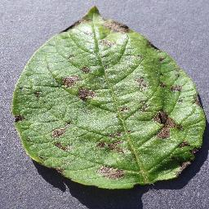
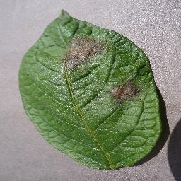
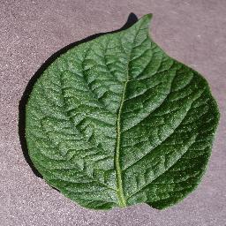
About dataset
This dataset contains 2152 images belonging to 3 classes.
3 classes
Potato Early blight
Potato Late blight
Potato healthy

Slide 4
Workflow of this project:
Collecting data
Load data into tf.data:Tensorflow input Pipeline
Data visualization
Train ,validation,Test split into the data
Optimize the performance of tf.dataset.input pipeline
Data pre processing
Data augmentation
Build and train a CNN model
Plot training history on graph
Final prediction & accuracy of model.

Slide 5
Data collection:
3 type of data collections are there.
buy data from third party vendor.
collect & annotate data on our own.
Write web scraping scripts to collect image from internet.
Here I collected data from Kaggle.com
Load data into Tensorflow Input Pipeline(tf.data.dataset)
Here I build the data input pipeline.it is also called as ETL(Extract Transform Load) all kind of transformation.
Using this data for input pipeline doing batch loading, shuffling, filtering, mapping all of this called ETL.
The input pipeline is a quick and easy utility provided in tf.data api to make complex input pipeline from simple and reusable codes and all in few lines of code.
Tf.dataset has a lot of good apis to support the transformation.
So overall we can do lot of transformation like filtering, mapping, shuffling, scaling using tf. Dataset.

Slide 6
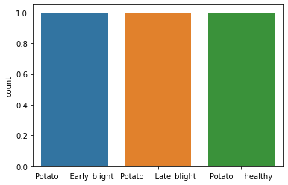
Exploratory Data Analysis: We perform the necessary analysis on the data to get meaningful insights

Slide 7
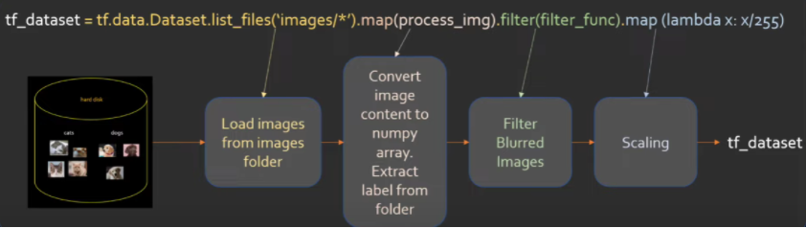
Tensorflow input pipeline benefits:
handle huge datasets by streaming them from disk using batching.
Apply transformation to make dataset ready for model training.
s
Splitting the data:
splitting the data into training, validation, testing.
Training data 80%,validation data10%,testing data 10%

Slide 8
Optimize the performance of tf.dataset.input pipeline:
here I optimized the tf.dataset.input pipeline using prefetch and catching.
This can done by prefetch API & cache API.
When we do optimization on train, validation, testing data ,the training process will happen quickly for that we use cache, prefetch
Data preprocessing:
rescaling
resizing
data augmentation
Data augmentation:
To make our model robust I used here the concept of data augmentation.
data augmentation is a process of artificially increasing the amount of data by generating new data points from existing data.

Slide 9
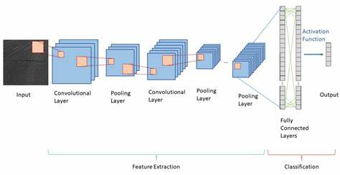
Build and train a CNN model
Here I build a model using convolutional neural network.
CNN architecture below:

Slide 10
CONVOLUTIONAL NEURAL NETWORK
Convolution neural network is a deep learning method which is broadly used for image classification, image recognition ,object detection etc.,
In this project, we will see how CNN's can be used for image classification and regression. For this, the model takes an image as input ,processes it and classifies it under a certain category. An image is collection of pixels, with features which specifies the height, width and the dimensions of the image.
For example- image with 6x6x3 dimensions signifies that it is an rgb (red, green, blue) color image while an image with dimensions 6x6x1 signifies a grayscale images.

Slide 11
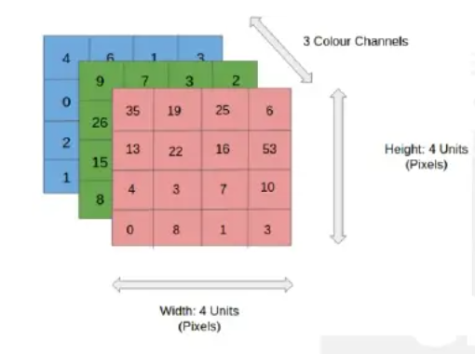
CONVOLUTIONAL NEURAL NETWORK
In the figure, we have 4x4x3 RGB image which has been separated by its three color panels- RED,GREEN and BLUE. The height and width of image is 4. In grayscale image ,the color channels will be reduced to 1.
There are a number of such color spaces for images such as Greyscale, RGB, HSV , CMYK etc.,
In the CNN model , the training and testing of the input image is performed by passing the image through a series of convolution layers with filters. These filters are also known as kernels.
This is followed by the pooling layers for feature extraction ,the dense layers and finally ‘SoftMax’ function is used for classifying the object within a probabilistic range of values of 0 to 1.

Slide 12
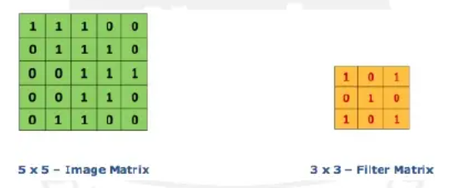
CONVOLUTIONAL NEURAL NETWORK
CONVOLUTION LAYER
The convolution layer is first layer of CNN model architecture which starts to extract features from the input. The convolution layer operates with two inputs, One is the image matrix while the other being the filter or kernel.
The convolution layer safeguards the relationship between the original image pixels by learning the features of the image using small square patches.
In the figure, we have an image matrix of size 5x5 and a kernel size of 3x3.The image values are 0 and 1. Therefore to obtain a ‘Feature map’ we multiply the image matrix with the filter.

Slide 13
POOLING LAYER Pooling layer is another extremely significant feature of convolution neural networks. Pooling layer will resolve to reducing the number of parameters when the image are large. Pooling is also known as subsampling or down sampling which helps us to reduce the dimensionality of each feature map by leaving out trivial traits and retaining all the important information.
FULLY CONNECTED LAYER
Every CNN architecture is provided with a fully connected layer of neurons at the end.
As in CNN, neurons in a fully connected layer have fill connections to all activations in the previous layer and work similarly.
After training , the feature vector from fully connected layer is used to classify images into distinct categories.
Every activation unit in the next layer is coupled to all inputs from this layer.

Slide 14
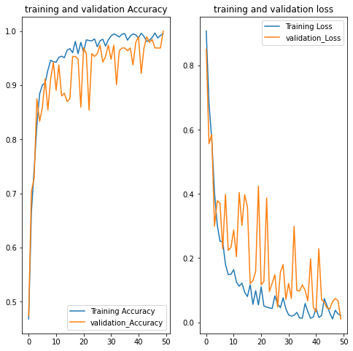
Results and predication PLOT THE RESULTS

Slide 15
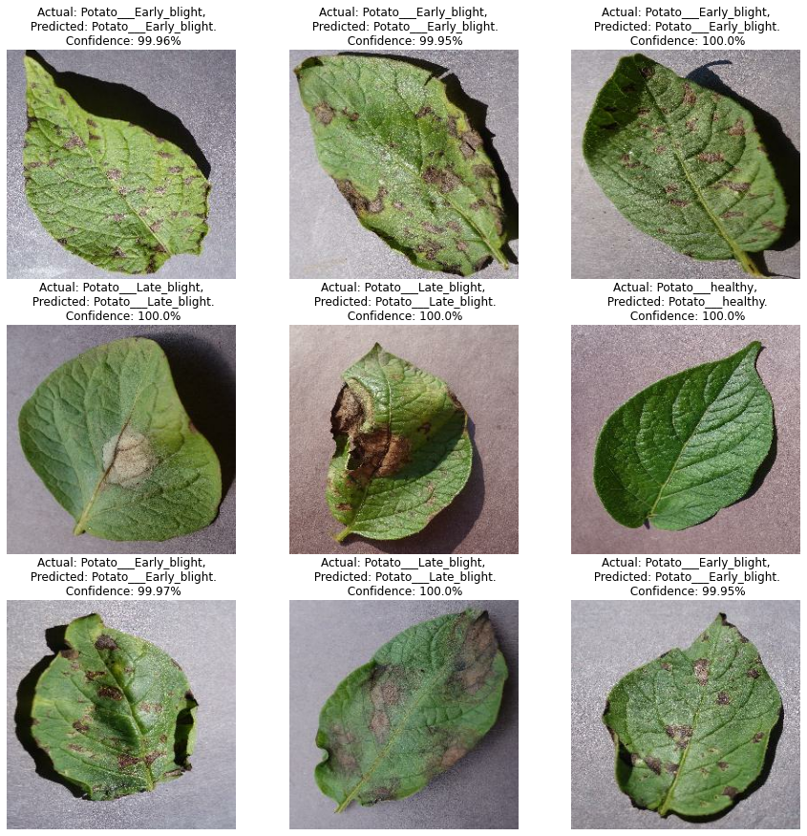
Results and prediction After training the model we evaluate the test data. We got the accuracy for test data is 98.83%

Slide 16
Conclusion and future scope
After building, training a model we evaluate the model performance using test data.
Evaluating the model using test data we got 98.83% accuracy. So our model perform well for the potato leaf disease image classification.
When we provide a unseen data it will classify well.
Training the model by increased the no. of epochs can give better and more accurate results.
The no. of layers of the model can be increase to process large dataset.

